Slide 1

Glutathione upregulation via Free Form amino acid supplementation + selenomethionine cofactor
Restoring Health, Resiliency, Readiness and Long-term Effectiveness of the Armed Services Soldiers, Sailor, Airmen and Marines
by TheBestImmuneSupport.com
Founder - Joseph V Cassarino
info@thebestimmunesupport.com

Slide 2

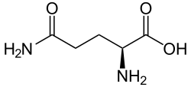
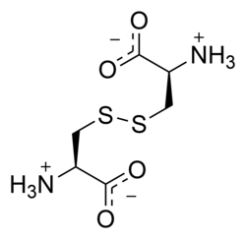
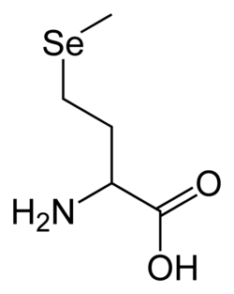
Free form amino acids in ProImmune:
Glycine
L-Glutamine
L-Cystine
Co-factor
Selenomethionine
Basis of ProImmune Effectiveness
Particle size composition – improves uptake
Reduced toxicity: No L-cysteine
Free form amino acids: Body uses what it needs
Selenomethionine improves absorption
Selenomethionine improves glutathione levels
Found in Brazil nuts, cereal grains, soybeans, and grassland legumes
Selenomethionine is absorbed 19% better than selenite.

Slide 3

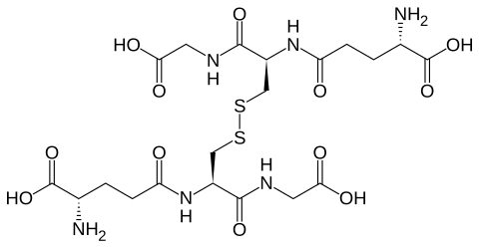
Reduced state
Glutathione (GSH)
NADPH + H2O
NADP+ + OH−
Glutathione disulfide (GSSG)
Oxidized state

Slide 4
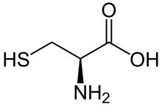
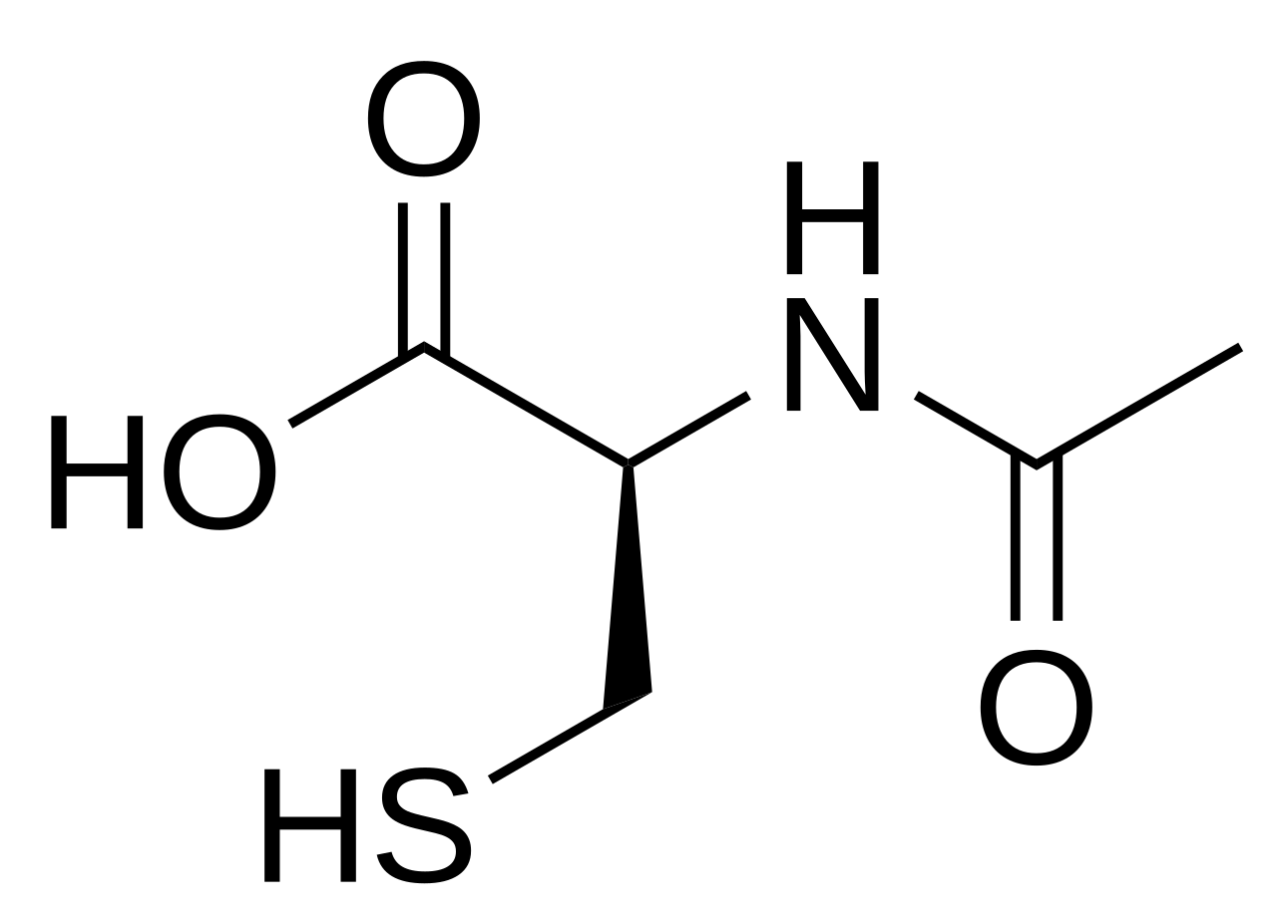
Glutathione
Rate limiting step in GSH production
N-Acetyl-L-Cysteine (NAC)
L-Cystine (from ProImmune)
L-Cysteine
Acyclase I

Slide 5
Traumatic Brain Injury and PTSD – Glutathione Connection
A concussion is under the TBI category – no such thing as a mild TBI in terms of health.
Rest and time are the only recognized treatment for TBIs
Undiagnosed TBI is a contributor to the suicide epidemic in service members
TBI is often misdiagnosed as PTSD and vice versa – symptoms overlap 90%
Concussions cause brain inflammation
  Secondary and persistent damage to brain regions, blood flow and neurons
  GSH levels drop after a TBI (CSF level determination)(DOI: 10.4103/1673-5374.257520)
  Oxidative stress markers increase after a TBI
  NRF2 Promoter elements are down-regulated after TBI (DOI: 10.1523/JNEUROSCI.1683-07.2007)

Slide 6
Supplementation with NAC improves TBI symptoms
(Good News/Bad News)
NAC produces significant behavioral recovery after injury in mouse model of TBI (DOI: 10.1371/journal.pone.0090617).
Tested In-Theater Vs Placebo (Iraq): Significant, short-term improvement in blast induced TBIs (DOI: 10.1371/journal.pone.0054163).
High dose NAC (oral) work for TBI: (4 gm loading then 2 gm twice daily)
  Problem with High Oral dosing: nausea, vomiting, headache, dizziness, diarrhea
  I.V. NAC is available but limited
  Low bio-availability in oral route

Slide 7
Supplementation with ProImmune improves TBI/PTSD & Anxiety symptoms
(Historical Background)
Glycine supplementation has neuro-modulatory effects (DOI: 10.9740/mhc.2016.11.266):
  Glycine acts on strychnine-sensitive glycine receptors (GlyRs), similar to GABA
    Acts in an inhibitory fashion to reduce anxiety
  Glycine is a requisite co-agonist on the NMDA subtype-ionotropic glutamate receptors
    Helps to stimulate brain activity for memory formation
  Glycine is a mood-stabilizing amino acid that helps with stress and anxiety (DOI: 10.19163/2307-9266-2022-10-5-404-415)
Testimonial from Denver Police Department Captain of 32 years:
  Retired head of security for Denver PD
  Diagnosed with PTSD from service related trauma
    “Nothing - not drugs, not therapy – took away my PTSD until I started taking Pro Immune”

Slide 8
Anything NAC can Do, ProImmune Does Better!
NAC has low bioavailability – free form amino acids do not.
L-Cystine has very low-toxicity at high dose – L-cysteine has toxicity
ProImmune delivers two L-cysteine for every one that NAC delivers
  L-Cysteine is the rate limiting step in GSH biosynthesis
  Selenomethionine in ProImmune boost GSH biosynthesis
ProImmune has pleiotropic effects – does more than help with TBI
  Glycine supplementation aids in recovery from sports injury and training (DOI: 10.3390/sports12100265).
  Glycine improves sleep and recovery (DOI: 10.3389/fneur.2012.00061)

Slide 9
Evidence of ProImmune’s Effectiveness
(Kidney and Vascular protection)
CKD (chronic kidney disease) is a public health problem (DOI: 10.1042/CBI20090349)
  Vascular smooth muscle cells (VSMCs) are a model for CKD
  Spermine induces apoptosis in VSMCs
  ProImmune was compared to NAC
    ProImmune was more effective than NAC in preventing spermine-induced apoptosis and downstream changes
    Cells were complete protected from damage

Slide 10
Evidence of ProImmune’s Effectiveness
(Kidney and Vascular protection)
CKD (chronic kidney disease) model in rats (PMCID: PMC3426391)
  Adenine supplementation (0.7%) in diet induces interstitial nephropathy
  Chronic renal failure (CRF) is the end symptom.
Three groups
  Control (No adenine in chow)
  CRF group (adenine in chow)
  CRF group plus ProImmune (adenine in chow)
Results
  CRF group produces azotemia, severe kidney swelling, nephropathy & poor GSH/GSSG ratio
  CRF group plus ProImmune significantly attenuated all symptoms; reduced pathology and improved GSH/GSSG ratio

Slide 11
ProImmune Keep GSH Levels High
(Intracellular GSH)
Tested against three glutathione (GSH) precursors (DOI: 10.1152/ajpcell.00434.2009):
  N-acetyl-cysteine (NAC)
  ProImmune
  NAC fortified with selenomethionine
Vascular Smooth Muscle Cells (VSMCs) treated with spermine (Spermine exposure reduces intracellular GSH levels)
  Treatment with NAC did not protect against GSH depletion.
  ProImmune maintained intracellular GSH at control levels.
  NAC + selenomethionine was 50% as effective as ProImmune

Slide 12
ProImmune Protects the Liver
(Inhibits Obesity & Metabolic Syndrome)
Nonalcoholic fatty liver disease (NAFLD): most common form of liver pathologies
Male apolipoprotein E (ApoE)-/- mice: Normal diet (ND) Vs. high fat diet (HFD)
  Mouse model for NAFLD (DOI: 10.1016/j.yexmp.2011.04.009)
  Oxidative stress increases with diet-induced obesity.
  HFD diet (compared to normal diet) produces:
    weight gain, hepatomegaly, and increased serum cholesterol and triglycerides levels.
    increased lipogenesis, oxidative stress
  HFD diet + ProImmune produces:
    fully prevented the adverse effects of HFD on serum triglyceride levels, body and liver weights, and hepatic steatosis.
    attenuated HFD-induced increase in lipogenesis, oxidative stress.
    Keeps healthy weight in HFD situations

Slide 13
ProImmune Inhibits Viral Infection
(Zika Virus – SARs-Cov-2)
Low GSH levels intra-cellularly are associated with increase viral replication potential
Infection assays: human placental cells and Vero cells (DOI: 10.1016/j.antiviral.2018.09.004)
  Zika will grow and replicate in both cells
  Infection with Zika reduces GSH levels
  ProImmune addition to uninfected cells caused no damage
  Supplementing with ProImmune inhibits replication by 90% in infected cells
*SARS & HIV outcomes (as Prothione formulation – based off of ProImmune): Phase II
  Mild to moderate SARS-COV2
    Lower hospitalization rates while taking Prothione
    Reduced SARs-Cov-2 viral load (PCR measure)
    Faster symptom recovery
  Reduced HIV viral load (PCR measure)
*Protocol #: TAL-PRO-001, Version 1.5, 20 September 2021; ClinicalTrials.gov ID: NCT04742725

Slide 14
ProImmune Shows Neuroprotective Effects
(No Surprise – If NAC works, ProImmune works better)
Case study (DOI: 10.3389/fneur.2024.1356662):
  78 year old patient with dementia
  Sundowner syndrome induced by elevation changes (travel thought the Rocky Mnts.)
  Non-verbal and non-mobile after car trip
    Proimmune + 1.3 ATA hyperbaric air (four, 1-hour sessions)
    Speech and activity of daily living improved and recovered to pre-dementia levels
Clinical experience with sports concussions:
  High dose ProImmune (every three hours) reverses symptoms (light sensitivity, headache, memory loss) after 24-48 hours.

Slide 15
Nuclear factor erythroid 2-related factor 2 (NRF2)
Upregulation via L-Cystine and L-Cysteine Levels
(ProImmune Activates NRF2)
NRF2 is a critical gene regulator against inflammation and ROS (DOI: 10.1146/annurev-pharmtox-011112-140320)
L-Cystine is a known NRF2 inducer (DOI:10.3390/cells12020291)
NRF2 regulates GSH synthesis (DOI: 10.1016/j.freeradbiomed.2008.10.040)
Active interest in activating NRF2 in noncommunicable diseases (doi: 10.1016/j.redox.2025.103569)
Three-for-one effect:
  Increased concentration of reduced disulfide bridges (L-cystine) signals NRF2 activation and GSH peroxide upregulation
  L-Cystine is a precursor in GSH de novo synthesis
  Nrf2-increases glutathione recycling (DOI:10.1016/j.freeradbiomed.2008.10.040)
  Selenomethionine is a co-factor that stimulates GSH peroxide

Slide 16
ProImmune For Erectile Dysfunction
(Protects and Enhances NO production)
If NAC (or GLY-NAC) can do the job, ProImmune will do it better (and more thoroughly)
In a bilateral cavernous nerve crush (BCNC) rat model (DOI: 10.4103/aja.aja_17_20):
  NAC reduces fibrosis
  Maintains penile length
  Preserves intra-cavernosal pressure/mean arterial pressure
  Preserves NO induction
In a chronic intermittent hypoxia model (sleep apnea) in rats (DOI : 10.1016/j.urology.2015.07.013)
  NAC prevented apoptosis in penile tissue
  Preserved erectile function
  Preserves NO induction
Rat hyperlipedimia (DOI: 10.4103/aja202324) and diabetes models (DOI: 10.1111/jcmm.17394):
Both models result in ED in rats and mice
  ProImmune prevents hyperlipedimia
  NAC preserved penile tissue and erectile function in rats
  NAC inhibits apoptosis in penile tissue

Slide 17
ProImmune Versus Gly-NAC
(Pros and Cons)
Glycine + NAC (Gly-NAC)
Liver & Kidney detoxification
Low bioavailability
Low to no cell membrane permeability
Low glutathione synthesis
High doses cause side effects
ProImmune
Liver & Kidney detoxification
High bioavailability
Cell membrane permeable
High glutathione synthesis/High recycling
High doses has no side effects
Evidence against viral infections
*Protective Effects of Brain Infarction by N-Acetylcysteine Derivatives. Stroke. 2018 Jul;49(7):1727-1733. doi: 10.1161/STROKEAHA.118.021755. Epub 2018 Jun 4. PMID: 29866754.
*N-Acetylcysteine ethyl ester (NACET): a novel lipophilic cell-permeable cysteine derivative with an unusual pharmacokinetic feature and remarkable antioxidant potential. Biochem Pharmacol. 2012 Dec 1;84(11):1522-33. doi: 10.1016/j.bcp.2012.09.010. Epub 2012 Sep 20. PMID: 23000913.
*N-acetylcysteine ethyl ester as GSH enhancer in human primary endothelial cells: A comparative study with other... Free Radic Biol Med. 2018 Oct;126:202-209. doi: 10.1016/j.freeradbiomed.2018.08.013. Epub 2018 Aug 14. PMID: 30114478.

Slide 18
ProImmune Does More Than Increase GSH
(A “One Stop Shop” for health and wellness)
Glutathione is a master antioxidant
  Helps control and reduce reactive oxygen species (ROS)
  Helps to remove heavy metals
  Helps the liver and kidneys clear toxins
  Protects organ function
  Boost immune function and viral clearance
  Supports brain health
  Prevents and helps protect against erectile dysfunction
  Supports fertility
ProImmune component amino acids support:
  TBI and PTSD recovery
    Mood stabilization (stress and anxiety reducer)
  Recovery from injury
    R educes inflammation
    Reduces lactic acid build-up
For all that ProImmune does, it is a bargain for the end user.
Non-toxic
Easy to take
  Oral
  Inhalable
Portable
Excellent shelf life
Helps in weight maintenance

Slide 19
ProImmune – A health formula that can be licensed to DoD – either as a supplement or a medical intervention – or jars may be purchased in bulk from the authorized distributor TheBestImmuneSupport.com
Pro Immune can also be produced by the DoD (or manufacturer of choice) after a formulation/recipe license is agreed upon for any of the below commodities of choice:
1 – Powder formulation
2 – Compressed tablet formulation
3 – Inhalable powder formulation
4 – Intravenous (I.V.) delivery
5 – Nutrition bar

